Slide 1
A Study on
Marco Polo's View of China

Slide 2
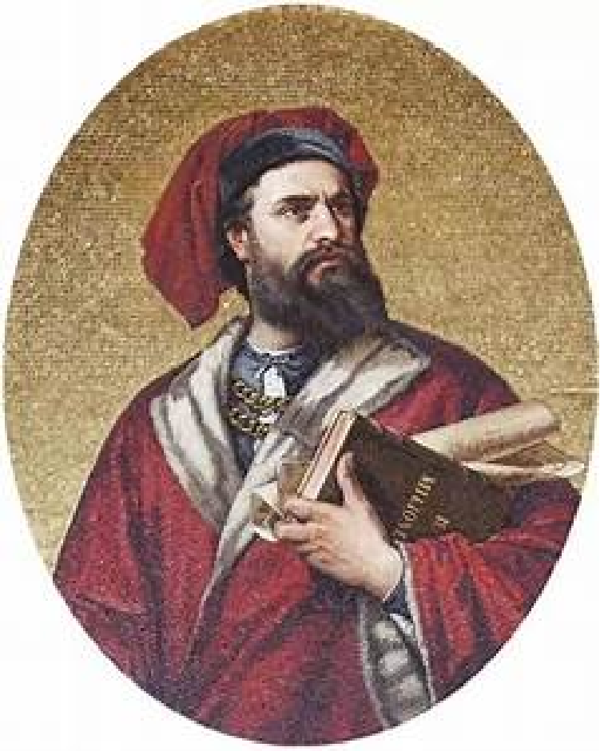
Project Background
Marco Polo（1254—1324） was an Italian merchant and traveler. At the age of 17, he embarked on a journey to the Orient with his father and uncle. During his 17-year stay in China, he explored many regions, including southwest mountain area and the southeastern coastal area. Upon his return to Italy, Marco Polo was captured in a battle and imprisoned. While in prison, he recounted his experiences and adventures during his travels. With the assistance of his cellmate Rustichello, he documented his travels in the famous book ——The Travels.

Slide 3
Project Introduction
The objective of this project is to utilize ancient cartographic maps of China, dating back to the time of Marco Polo, to showcase the locations he visited during his travels in China and the concerns he expressed about them in his narratives. Unlike the travelogues of Chinese literati of the same period, Marco Polo's preoccupations were unique. As a merchant, he was naturally interested in local industries and specialties, and meticulously recorded the prices of goods in his books. Additionally, as a devout religious believer, he was also concerned about the state of faith of the local people. Therefore, we decided to present the cities mentioned in Marco Polo's travels in three areas: religion, specialties and economic activities,, which he frequently mentioned in his accounts. The website will provide an interactive and informative experience for users, enabling them to explore and comprehend the historical routes of Marco Polo's travels in China, while also gaining insight into the local customs he described.

Slide 4
Research Question(s)
This research project aims to investigate what Marco Polo's perception of China was like during his two missions in China.
By analyzing his accounts, the project seeks to reveal the social reality of the Yuan dynasty as perceived by Marco Polo.
Additionally, the project aims to verify the authenticity of Marco Polo's narratives by comparing his travels with historical books and expert opinions.

Slide 5
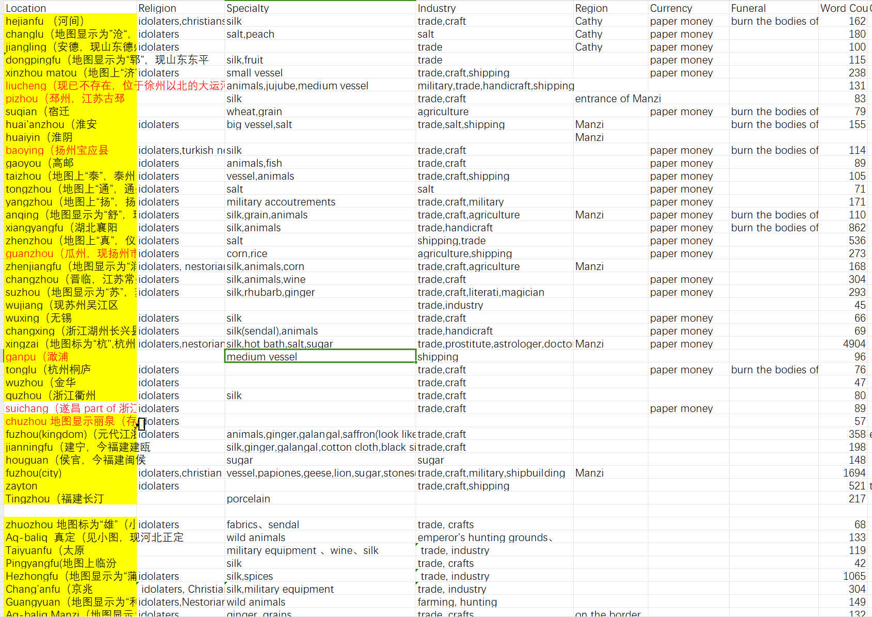
Workflow
1. Initially, we conducted a comprehensive compilation of Marco Polo's travels, focusing specifically on his two missions in China: From Beijing to Bengal and From Beijing to Quanzhou. Our compilation involved recording the conditions of the cities mentioned by Marco during his travels, including their religious beliefs, main industries, and products. Additionally, we analyzed the number of words that Marco used to describe each city.

Slide 6
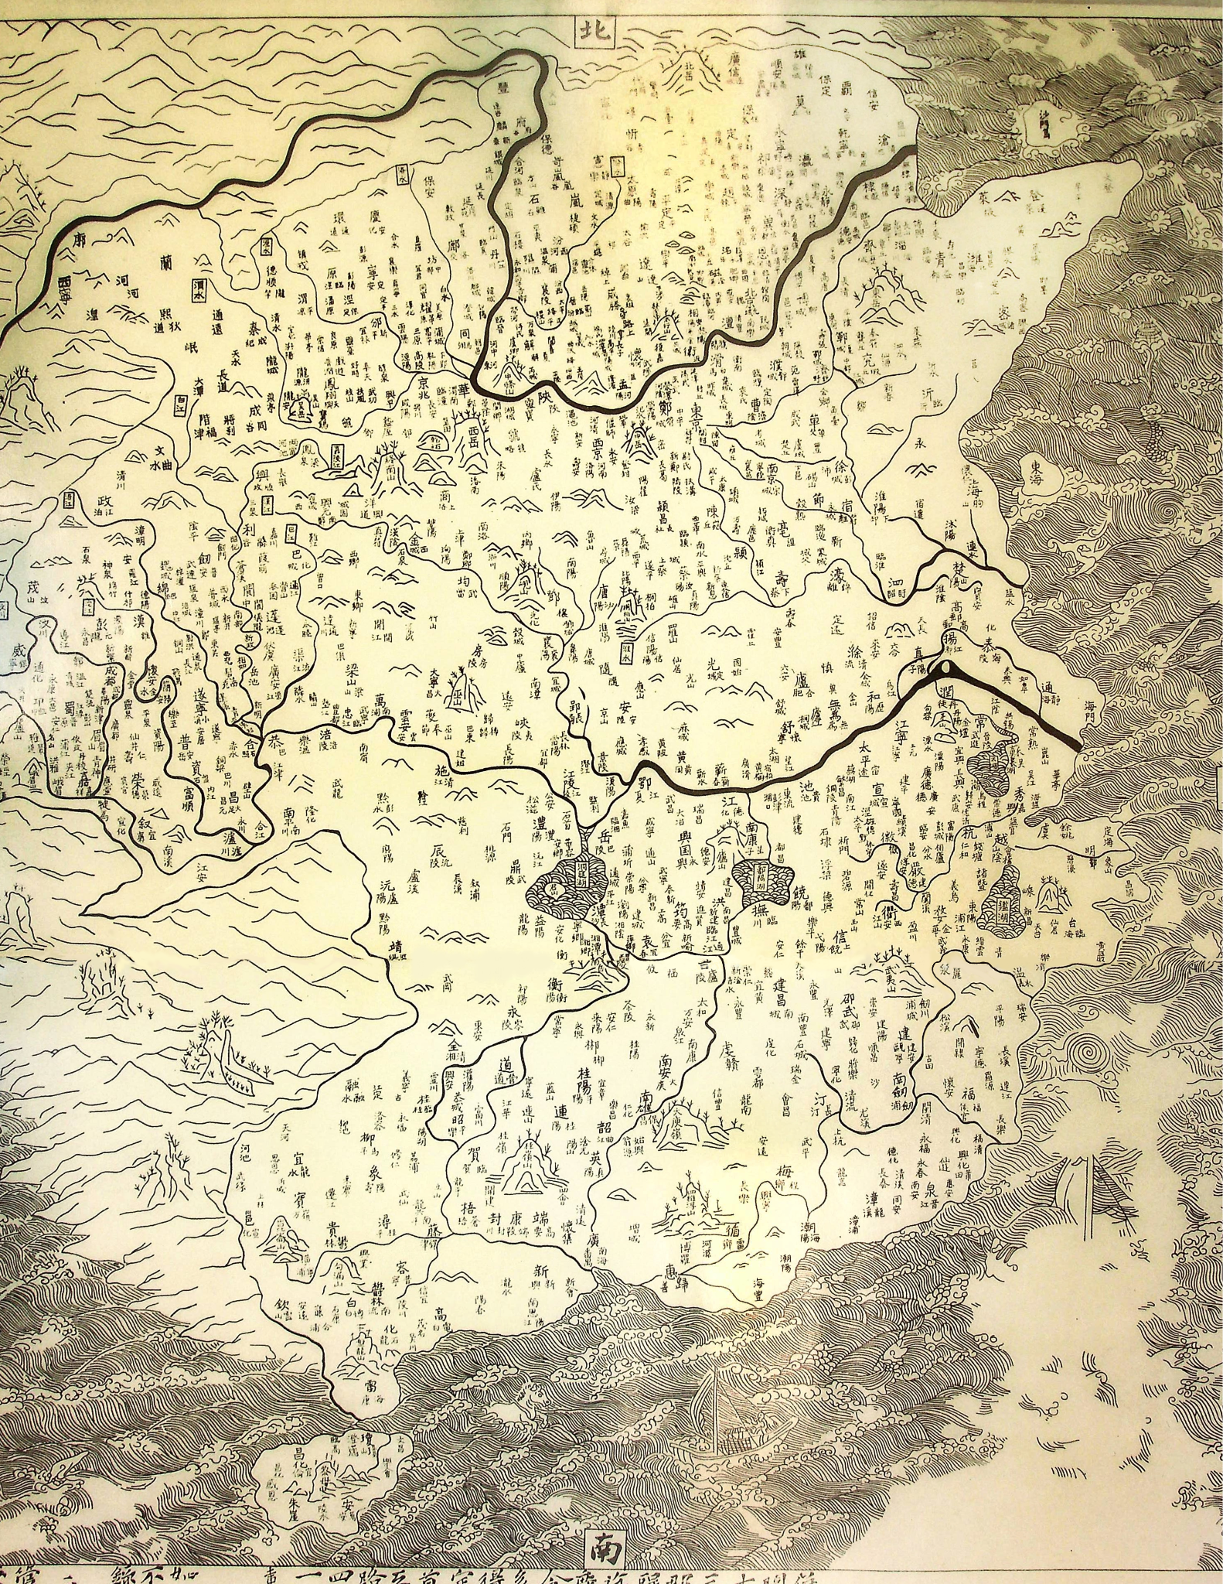
Workflow
2. With the assistance of our teachers, we were able to locate a Song Dynasty map that closely aligns with the time of Marco Polo's visit to China. This map serves as a base map to display the places where he traveled. By utilizing this historical base map, users are able to visualize the geographical context of Marco Polo's travels, providing a better understanding of the challenges and opportunities he encountered.

Slide 7
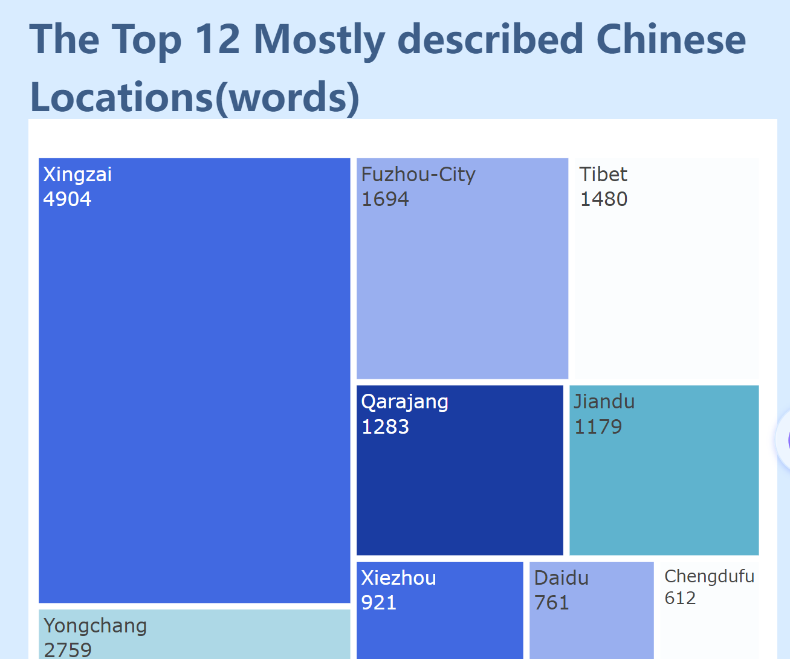
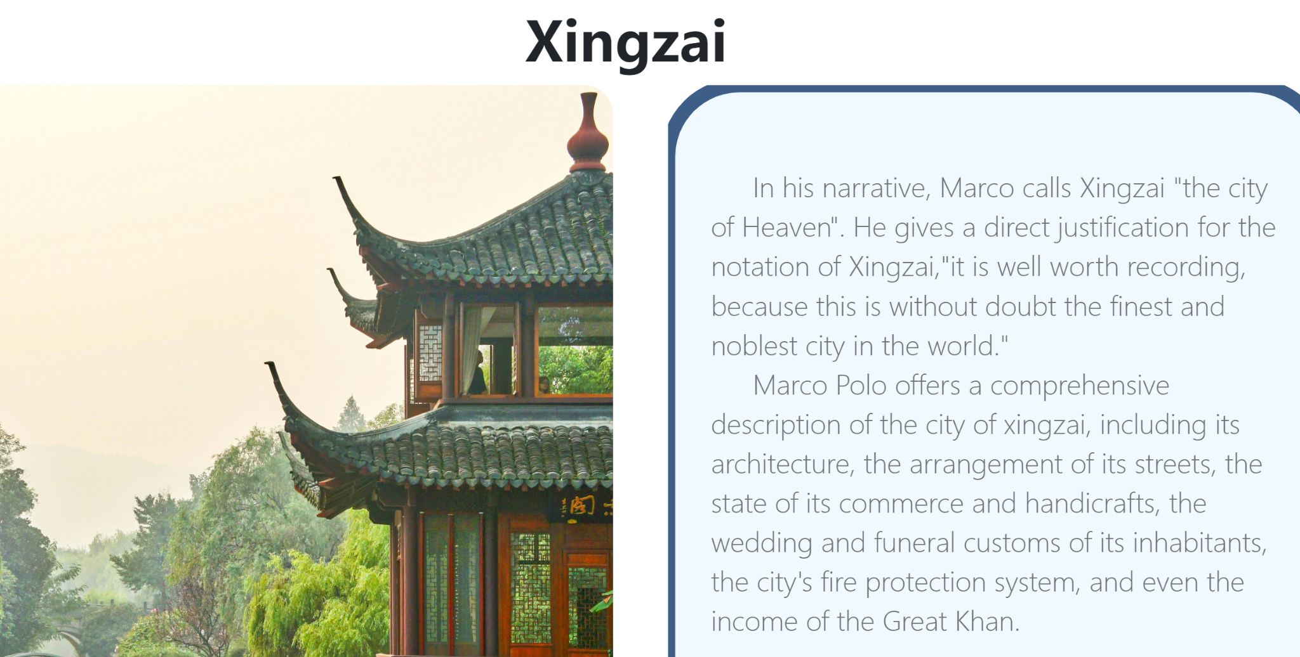
Workflow
3. Furthermore, we have identified the Top 12 Most Described Chinese Locations, based on the number of words used by Marco Polo in his narratives. These cities were chosen for further analysis due to their significance in Marco Polo's travels, which often focused on commercial, folklore, or religious information. Through this analysis, we aim to provide users with a deeper understanding of Marco Polo's view of Chinese cities.

Slide 8
Project Demonstration
http://10.79.165.26:5500/website.html

Slide 9
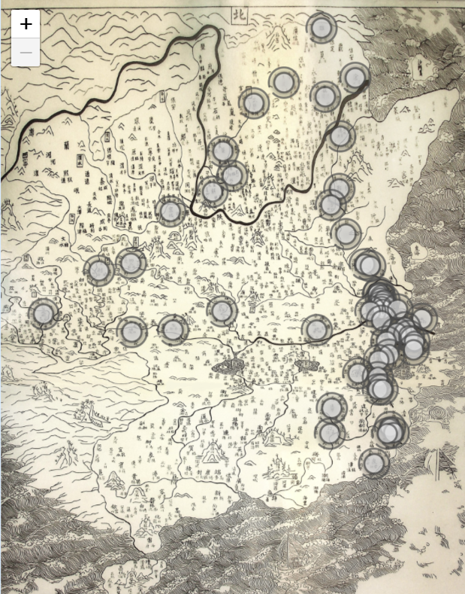
Findings
Can Density of markers suggest the Level of Prosperity?
江浙行省 5882112戶
江西行省 2332811戶
湖廣行省 2770451戶
中書省 1355354戶
河南行省 800410戶
陝西行省 87690戶
四川行省 98538戶
甘肅行省 4691戶
《元代社會生活史》

Slide 10
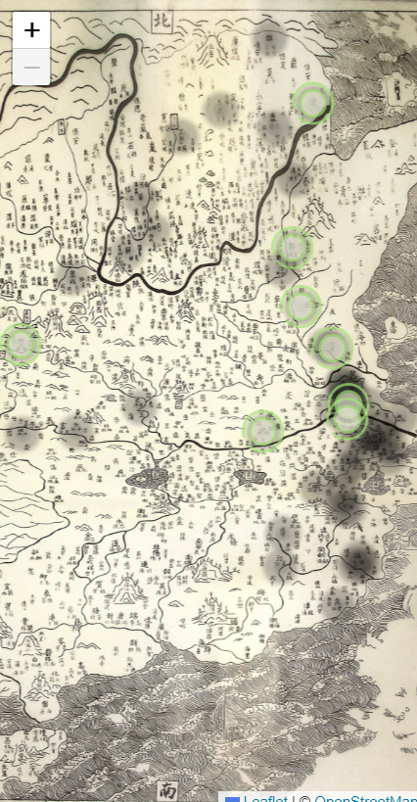
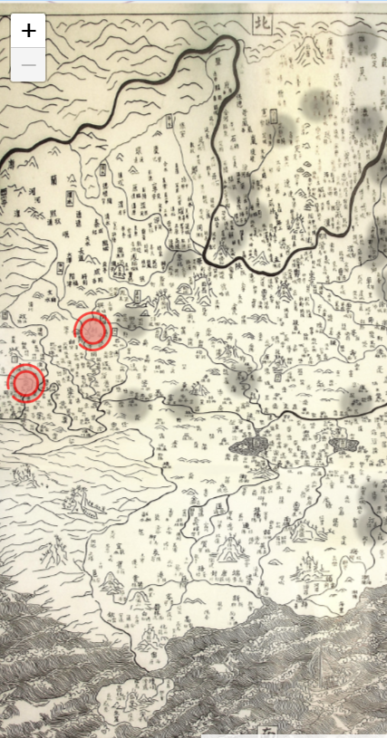
Findings
Can Density of markers suggest the Level of Prosperity of Different Economic Activities - e.g. Agriculture?
Left: agriculture products Right: agriculture
天下歲入糧數，總計一千二百十一萬四千七百八石。腹裏，二百二十七萬一千四百四十九石。行省，九百八十四萬三千二百五十八石。遼陽省七萬二千六十六石。河南省二百五十九萬一千二百六十九石。陜西省二十二萬九千二十三石。四川省一十一萬六千五百七十四石。甘肅省六萬五百八十六石。雲南省二十七萬七千七百一十九石。江浙省四百四十九萬四千七百八十三石。江西省一百一十五萬七千四百四十八石。湖廣省八十四萬三千七百八十七石。（元史 - 《卷九十三》）

Slide 11
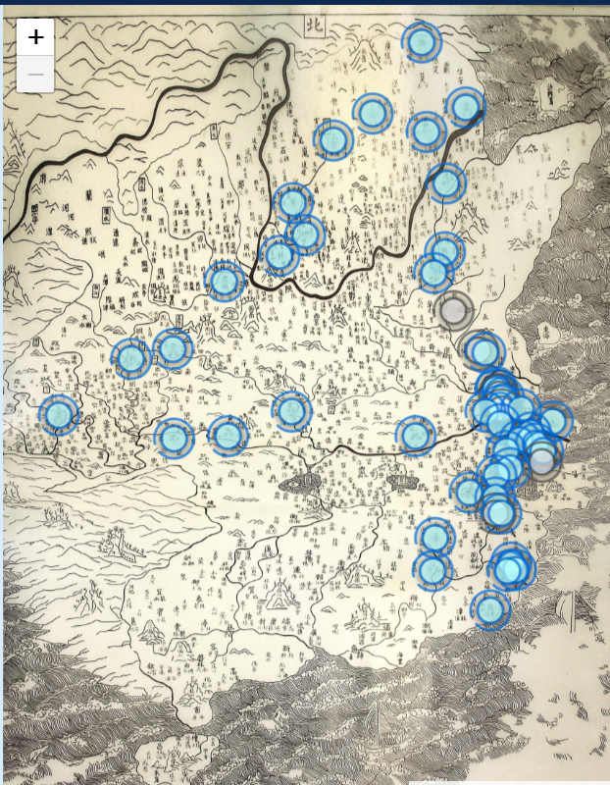
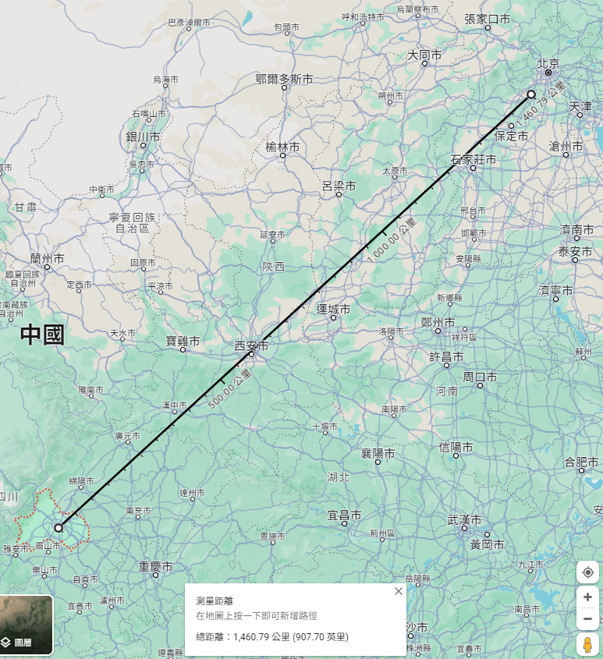
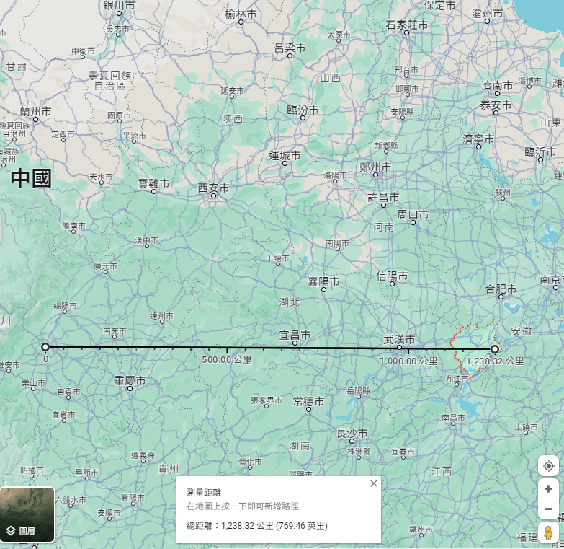
Findings
Chengdufu-Zhuozhou: 1460km/10marks=146km/marks
Chengdufu-Anqing: 1238km/5marks=247.6km/marks

Slide 12
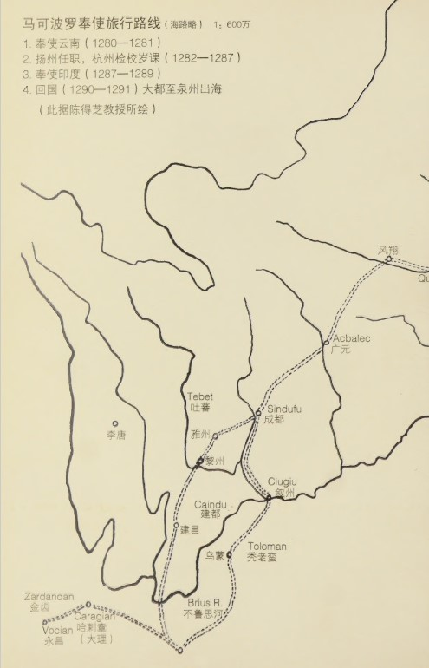
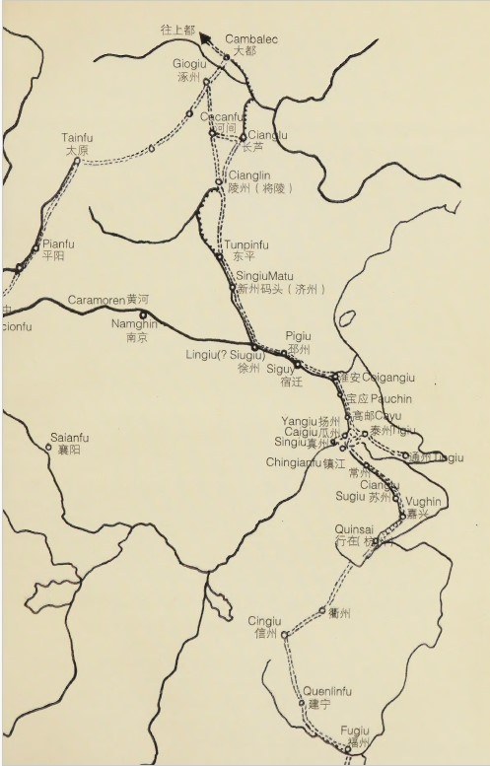
Findings
Marco Polo left his route suddenly to talk about Anqing and Xiangyangfu (Yangzhou-Anqing-Xiangyangfu-zhenzhou)
Xiangyangfu: The story told by Marco Polo includes intentional changes
Anqing: mixing up Nanjing and anqing
Kuizhou: only mentioned its geographical location
What could be the reasons for such narratives?

Slide 13
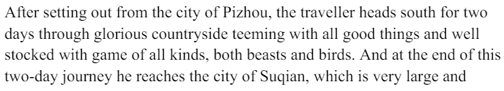
Challenges
1.Marco Polo also provide narratives for places between two cities. While, it is difficult to locate them on the map as the route of Marco Polo is not clear. The lack of Location Name identifying these places could also lead to confusion when people viewing and studying the map on the website.

Slide 14
Challenges
2. Overlaying the historical map on the modern map: As the historical map may not match the modern geography due to technology limitation of that time, the accuracy of overlaying the two map is estimated to be low.

Slide 15
Future Enhancement
Expansion of the study to include additional cities: The research can be expanded to include cities belonging to present-day China that Marco Polo mentioned on his way to China. This would provide users with a more comprehensive understanding of Marco Polo's travels and the regions he visited.
Translation of the website into Chinese: The website can be translated into Chinese to make it accessible to a wider audience. This would enable Chinese users to learn about Marco Polo's travels in China and gain insight into the local customs and traditions he described.
Expansion of the website's content: The website can be expanded to include more information about the historical and cultural significance of the cities and landmarks mentioned in the travels. This would provide users with a more comprehensive understanding of the historical and cultural context of Marco Polo's travels.

